Slide 1

Britannica + NetDragon
Transforming Education in 2019 and Beyond

Slide 2


2
The leaders of tomorrow are being
shaped in the classrooms of today
How can we enable and empower these students in
a world that is changing rapidly and hard to predict?
Engage them? Excite them?

Slide 3
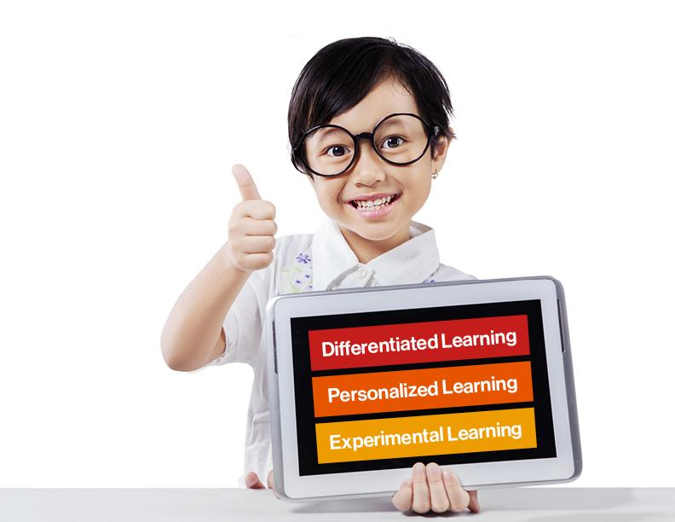
3
Imagine a world of…

Slide 4


4
Imagine a world where a child is engaged and excited by school and wants to tell their parents what they learned!

Slide 5

5
And a teacher
that can create a better connection with her students …and using her new tools and standards to develop critical skills for them…

Slide 6
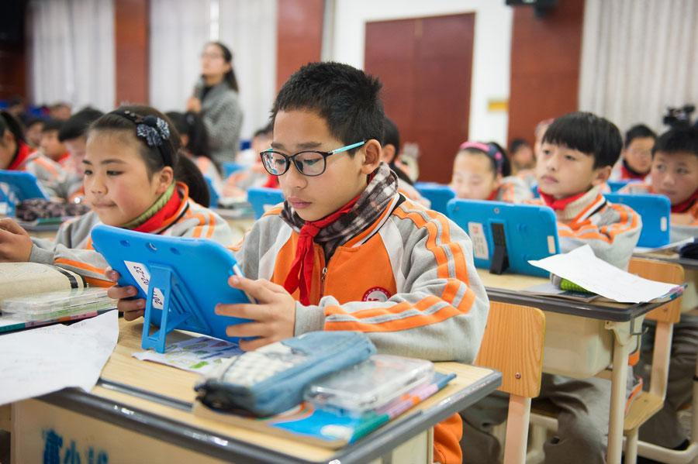
6
The key to modern learning:
The 4 P’s

Slide 7
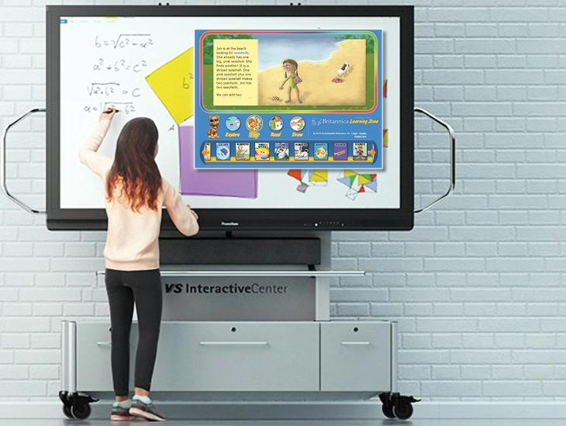

7
Britannica has reimagined how students learn and discover
Imagine an active classroom, where digital solutions enhance critical learning outcomes.
Where teachers and students feel connected and inspired.

Slide 8


8
“Together we can lay the foundation to prepare our future leaders of tomorrow.”
Let’s find out how

Slide 9

9
Our Approach
Britannica partners with Ministries of Education and develops custom, curriculum solutions that bring to life the country’s education vision.
And has become a committed partner in supporting educators, reaching 150+ million students across 83+ countries in over 15+ languages.

Slide 10

10
Our Method
We work hand-in-hand with government bodies to understand the priorities and develop unique customized, results-driven solutions and ongoing support.
Identify
Strategize
Develop
Implement
Guide
Impact

Slide 11

11
Britannica brings together

Slide 12
99
12
Ensuring personalized learning approaches are accessible to every educator
Preparing globally minded students
Adapting to evolving education trends and needs
Making strategic, data-informed decisions
1
2
Save Time, Be Sure, Learn More
Flex with Evolving Education Trends
Personalize Learning
3
Learning Adaptive Solutions
Leverage Partner Resources
Prepare Globally-Minded Students
4
Ease Adoption Barriers
Trust Scalable Solutions
Make Strategic Decisions

Slide 13

99
13
General Reference, Core Curriculum, and Supplemental
Platforms and Support
Key institutional products and services
Professional Learning Services

Slide 14
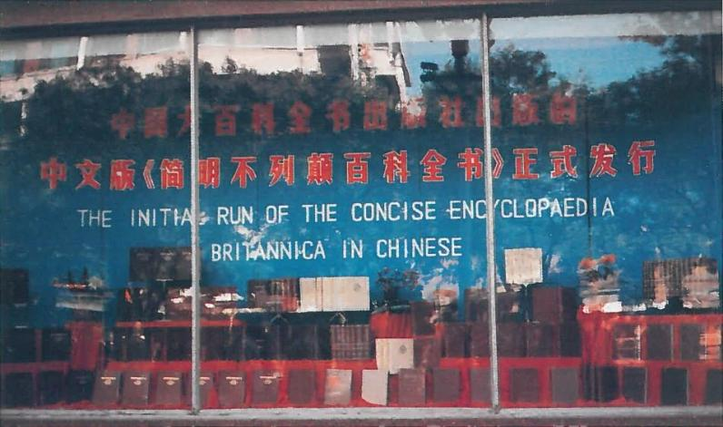

99
14
a
A Rich History of Working in China
The Concise Encyclopædia Britannica was published as a joint venture of the Greater Encyclopaedia of China Publishing House (an official agency of the People’s Republic of China) and Encyclopædia Britannica, Inc.

Slide 15

15
World Class Curriculum and Standards
a
Collaborators
Communicators
Media-savvy consumers with enhanced critical thinking, inquiry, and problem-solving skills.
Designed to shape a new future of classroom learning and lead group activity, Britannica’s customized, standard-focused solutions that transform students from passive learners into skilled

Slide 16





99
16
a
Professional Development
Public and Customized Webinars
Our team of experienced educators will work with your teachers to ensure that they feel confident, prepared, and eager to collaborate with colleagues and to motivate students, providing the best learning experience possible.
Face-to-Face Workshops
Ongoing Support

Slide 17
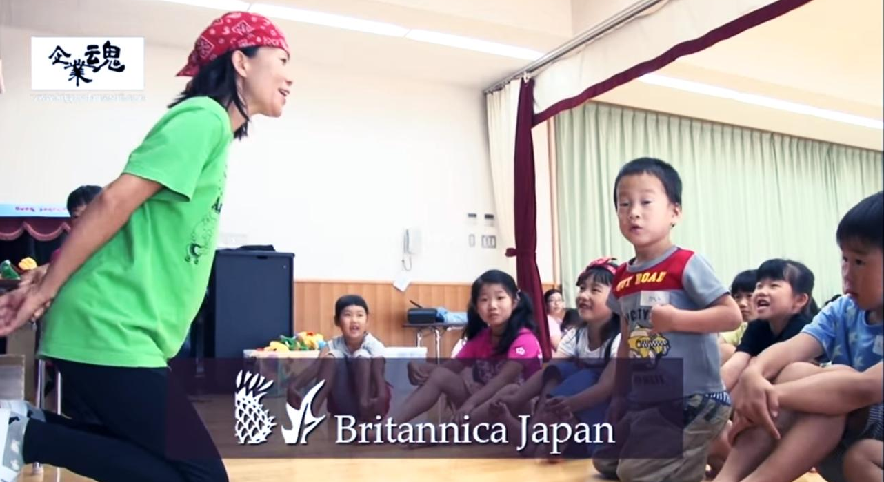

18
Britannica's English learning program "Angie & Tony" allows teachers to introduce English into their everyday activities in a fun and engaging way. This program gives benefits not only for children but also to parents and gives them an opportunity to connect with their child at home. By learning with parents and family, children will learn English with an easy mind and with great motivations.

Slide 18
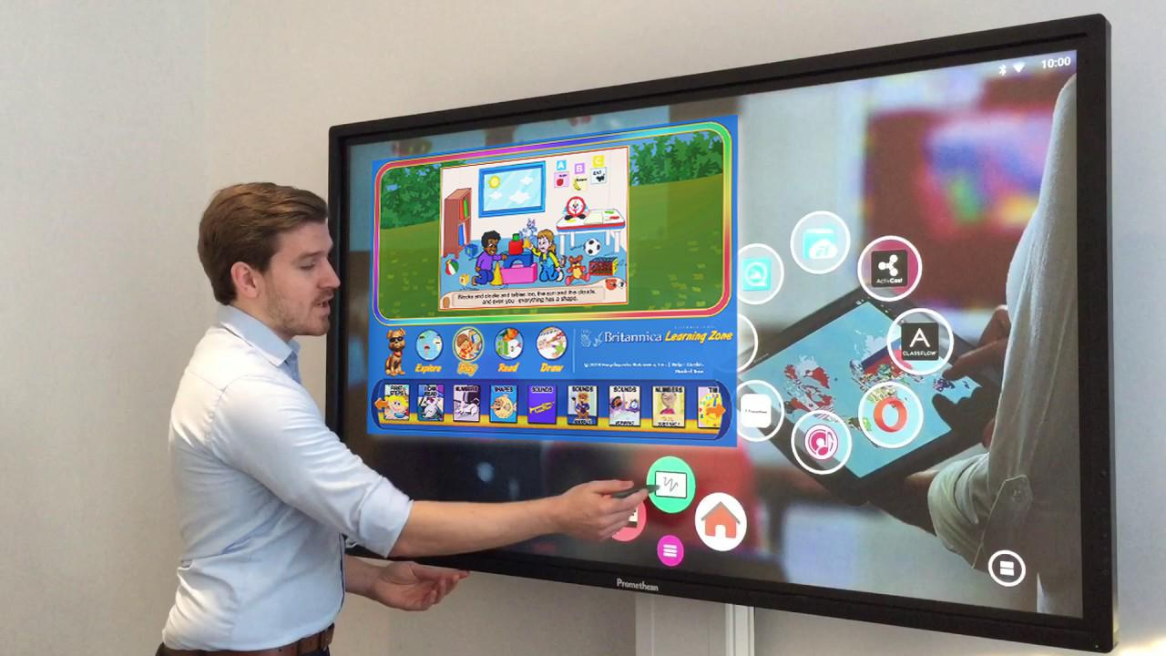

99
19
Cutting Edge Technologies
Combine our experienced, expert, world-class content with Net Dragon’s cutting edge technology and we have a perfect solution!

Slide 19

Case Studies

Slide 20
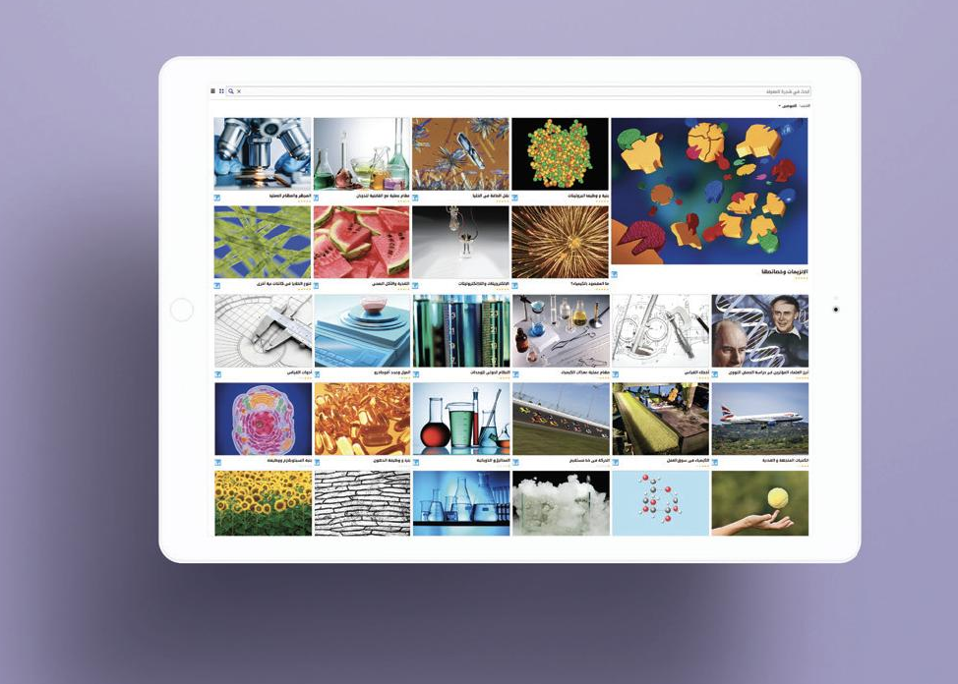
21
Egypt
“A creative and innovative society producing science, technology and knowledge, within a comprehensive system ensuring the developmental value of knowledge and innovation using their outputs to face challenges and meet national objectives.” Egypt Vision 2030

Slide 21
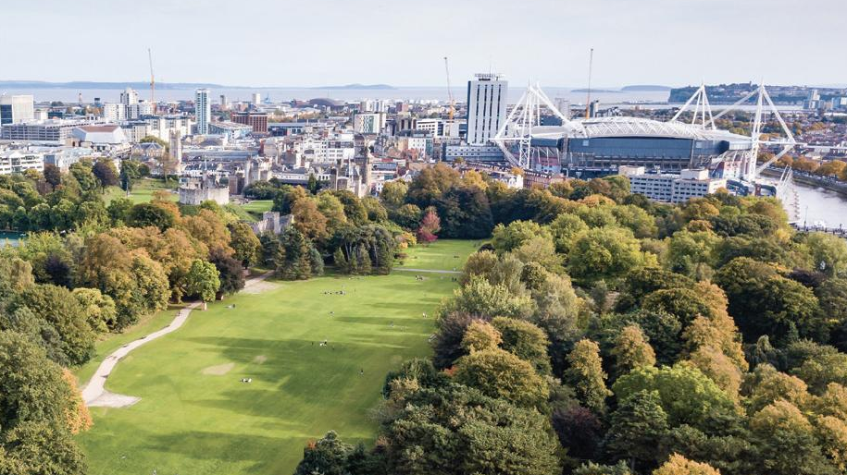
22
“Our national mission is to raise standards, reduce the attainment gap and deliver an education system that is a source of national pride and confidence. Parents and careers across the country must have confidence that their children attend schools that are preparing them well for their future lives, led by teachers who are passionate and talented, and that deliver qualifications that equip them for personal, national and international challenges and opportunities.”
Kirsty Williams, Cabinet Secretary for Education
Wales
Wales

Slide 22
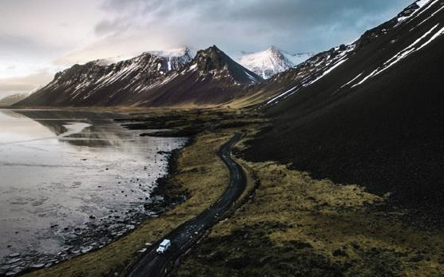
23
Iceland
“The aim of the Icelandic Consortium is to secure access to academic and scholarly content for students and staff of academic and research institutions and the general public in Iceland.” – from Icelandic Consortium

Slide 23

24
Why Britannica

Slide 24
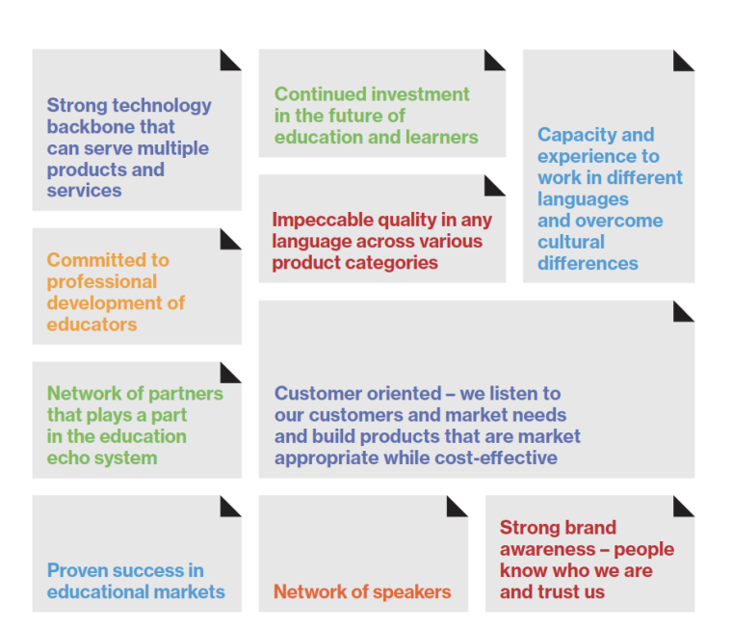
25
Our services

Slide 25
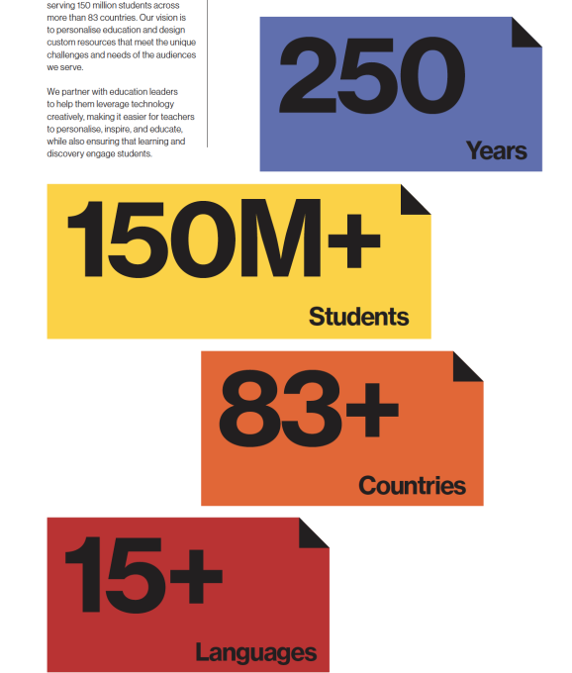
26
“A trusted brand on a journey to enable lifelong learning and transform education globally”

Slide 26

Encyclopaedia Britannica
Inspire curiosity and the joy of learning

